Slide 1
METALS AND NON-METALS
Chapter 6

Slide 2
INTRODUCTION
Pure substance is made up of the same kind of particles e.g gold
A mixture is a combination of two or more substances that do not react chemically and can be separated physically
Compound is a substance made up of two or more substances that are chemically combined

Slide 3
Periodic table of elements
Elements are arranged in order of increasing atomic number
Vertical columns of elements with similar properties are called group
Horizontal rows are called periods

Slide 4
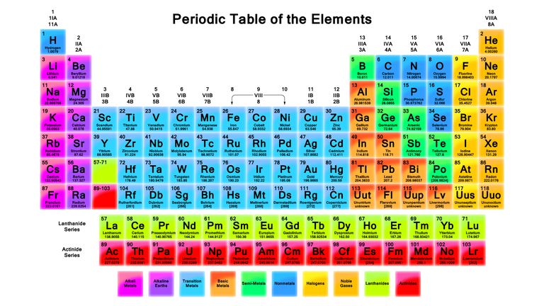
Periodic table

Slide 5
Metals and non- metals
Properties of metals
Hardness
Conduct Electrical and have good thermal conductivity
Have high density
Malleability and elasticity -Are malleable i.e can be hammered and rolled into sheet without breaking
Elasticity – some are able to return to their old or original shape after stretching e.g spring
Have high tensile strength- i.e do not break easily under normal forces and therefore they can be stretched into wires (ductility)

Slide 6
Difference between metals and non-metals
Metals | Non-metals
Are solids at room temperature | Are liquid or gases at room temperature
Are hard and strong | Are soft and brittle
Have lustre- shiny appearance | Have dull surfaces
Have high melting point and boiling points | Have low melting and boiling points
Produce a ringing sound when struck they are sonorous | Produces no sound when struck
Have high density | Have low density
Have high tensile strength | Have low tensile strength
Are malleable | Are non-malleable
Are ductile | Are non-ductile
Are good conductors of heat and e,ectricity | Are poor conductors of heat and electricity

Slide 7
Uses of metals
Jewellery .eg gold and silver
Construction e.g iron
Making doors and windows e.g aluminium is used in making door frames and windows
Coins and medals e.g silver and gold
Thermometers e.g mercury
Galvanizing e.g ti and zinc

Slide 8
Uses of non-metals
Sulphur for making sulphuric acids
Chlorine- for water purification
Inert gases- e.g helium is used in weather balloons
Neon- advertising signs
Argon- used in electric bulbs

